Slide 1
Developing a Cost-Effective Traffic Monitoring System Using Microprocessors
Smart Traffic Control and Monitoring System

Slide 2
Overview
This presentation outlines traffic management solutions using Raspberry Pi and Camera Module with real-time vehicle detection, pedestrian safety systems, and smart traffic control mechanisms.
Provide functionalities similar to expensive AI cameras at a fraction of the cost.
Team Rising Misfits

Slide 3
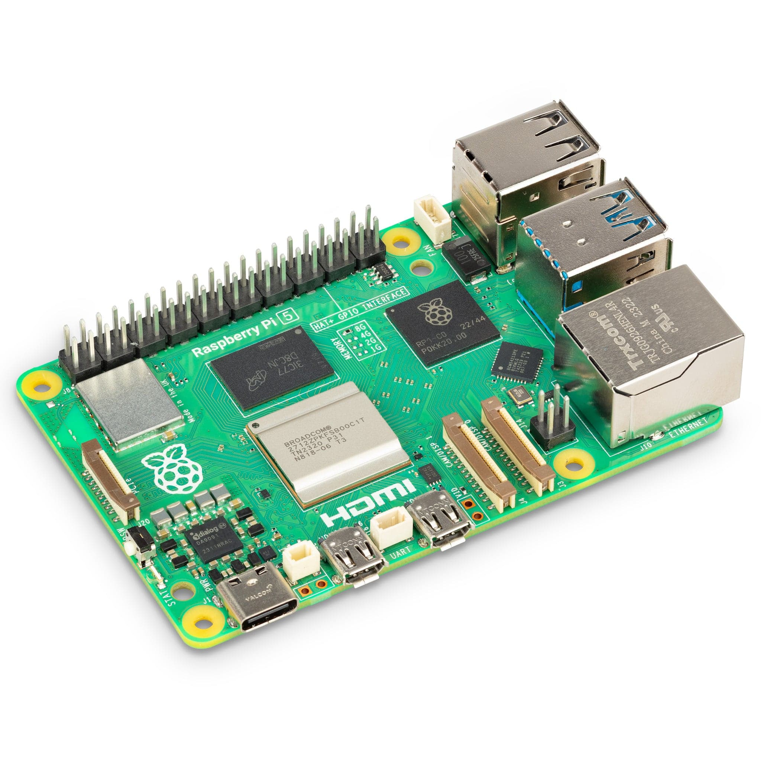
Introduction to Raspberry Pi
Limitations of Current Systems
Expensive AI Cameras:
Cost per Unit: ₹200,000 to ₹500,000 INR.
Total Cost for Multiple Junctions: Prohibitively expensive for widespread deployment.

Slide 4
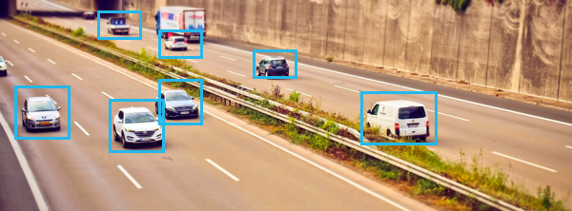
Vehicle Detection and Counting
• Uses Raspberry Pi Camera and OpenCV for real-time detection.
• Vehicle count displayed on-screen with bounding boxes around each vehicle.

Slide 5
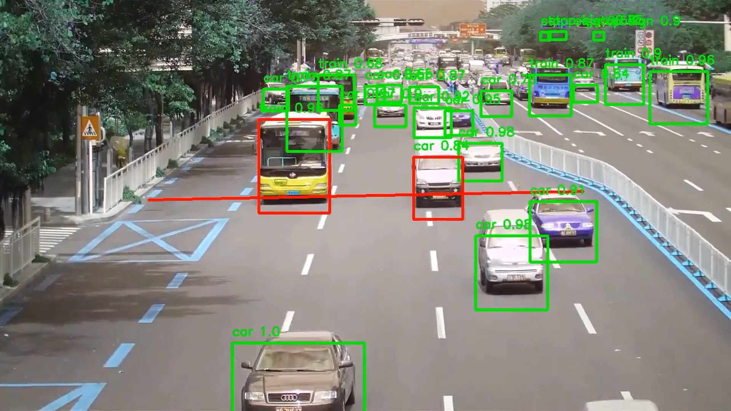
Red Light Violation Detection
• Detects vehicles violating red-light signals.
• Raspberry Pi controls the simulated traffic lights.
• Violation is flagged if a vehicle crosses the stop line during red light.
• Screenshots captured for the violating vehicle.

Slide 6

Cost-Effective Traffic Monitoring System
Components
Microprocessors (e.g. ) with camera modules.
Advantages:
Low Cost: Approximately ₹1,500 - ₹2,300 INR per unit.
Scalable: Affordable deployment across many junctions.
Flexible: Customizable through software development.
Energy Efficient: Low power consumption suitable for solar power.

Slide 7
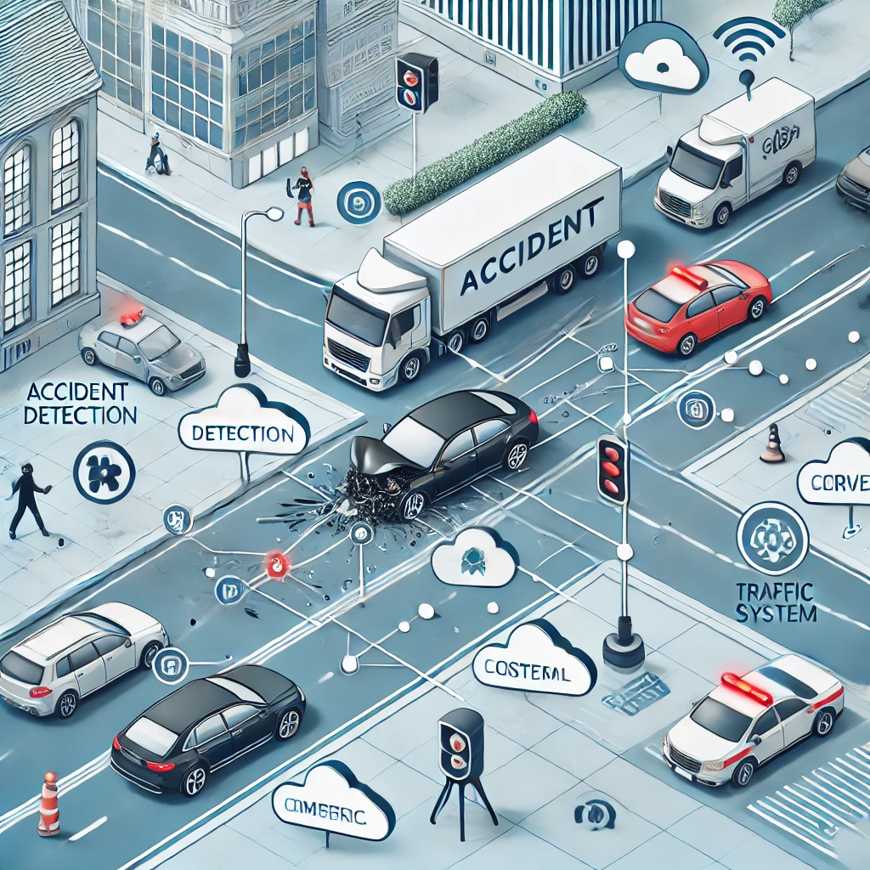
Accident Detection
• Uses vehicle motion analysis to detect sudden stops and collisions.
• Captures accident data and triggers alerts for quick response.
• Uses optical flow and real-time video analysis.

Slide 8
Key features of our model
-affordable
-scalable
-open source
-repairability
-upgradeability
-low power consumption

Slide 9
Cost Comparision
Traditional AI Traffic Cameras
Cost per Unit: ₹200,000 - ₹500,000 INR.
Installation & Setup: ₹50,000 - ₹100,000 INR.
Total Cost per Unit: ₹250,000 - ₹600,000 INR.
Proposed System
Microprocessor: ₹2500 - ₹5,000 INR.
Camera Module: ₹300 - ₹600 INR.
Mounts & Enclosures: ₹500 INR.
Power Supply (if needed): ₹200 INR.
Total Cost per Unit: ₹3,500 - ₹6,300 INR.

Slide 10
Use Cases of Our System
Number Plate Tracking (ANPR)
Captures images of vehicles and reads license plates using OCR.
Assists in enforcing traffic laws and tracking vehicles.
AI Traffic Prediction
Analyzes data to predict congestion patterns.
Helps in proactive traffic management and signal optimization.
Capturing Live Video
Streams or records live video feeds.
Enables real-time monitoring and quick incident response.
Detecting Traffic Build-up
Monitors vehicle density to detect increasing traffic.
Alerts authorities to manage congestion.
Red Light Violation Detection
Detects vehicles running red lights.
Enhances road safety and law enforcement.

Slide 11
Future Scope
• Integration with cloud for centralized traffic monitoring.
• Adding advanced AI models for predictive analytics.
• Scaling the system to cover more traffic junctions across the city.

Slide 12
Conclusion
• Raspberry Pi offers an affordable, customizable solution for traffic management.
• The system addresses real-time traffic monitoring, safety, and optimization.
• Scalable for deployment at various traffic hotspots for improved road safety and traffic flow.
Team Rising Misfits

